Slide 1
Analog Wiring
© 2014 John Sefcovic

Slide 2
WIRING METHODS
Single-ended Wiring Method
Single-ended wiring compares one side of the signal input to signal ground.
This difference is used by the module in generating digital data for the
controller.
When using the single-ended wiring method, all input devices are tied to a
common ground. In addition to the common ground, the use of single-ended
wiring maximizes the number of usable channels on the module
Differential Wiring Method
The differential wiring method is recommended for applications that may have separate signal pairs or a common ground is not available. Differential wiring is recommended for environments where improved noise immunity is needed.

Slide 3
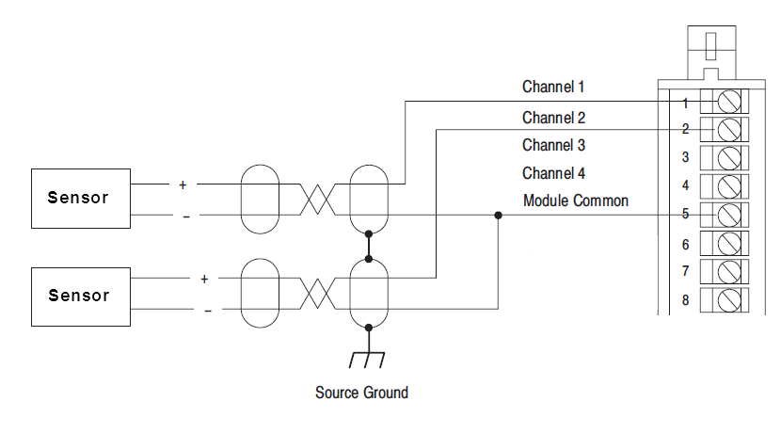
WIRING METHODS
Single-ended Wiring
Each sensor uses its individual signal (positive) connection.

Slide 4
WIRING METHODS
Single-ended Wiring
All sensors are tied to a
common (negative) ground.
Source Ground is for the shielded cable to protect against interference.

Slide 5
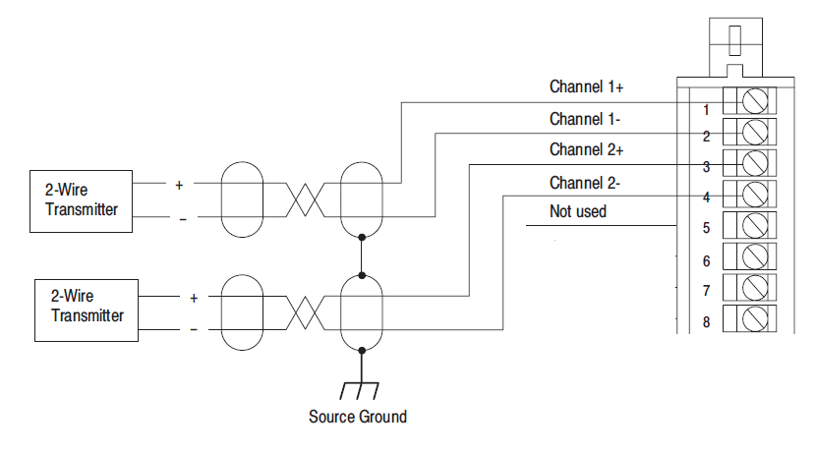
WIRING METHODS
Differential Wiring
Each sensor uses its individual signal (positive) and ground (negative) connections.

Slide 6

WIRING METHODS
These are generic wiring examples.
ALWAYS check manufacture’s wiring and electrical specifications.

